Slide 1

Projects Using React.js & Flux
Project 7: InfoFinder

Slide 2
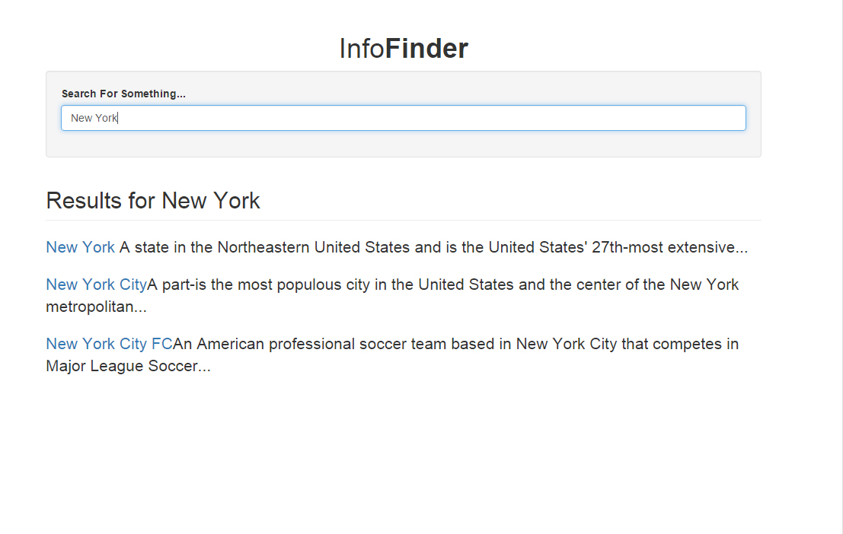
Project Description
InfoFinder is a search engine that is powered by the Duckduckgo API. It simply returns results using a GET request

Slide 3
Project Lectures
Section Intro
FluxBoiler Setup
Search Form
Fetch Data From API
Display Results

Slide 4
What You Will Learn
Create a Flux boilerplate
How to fetch data from Duckduckgo.com
How to display and map through results

